Slide 1
WEBSITE BRIEF

Slide 2
LOGO
The Expression of Our Visual Communication
The Logo Symbol A powerful symmetrical element represents the letters T & M. The logo evokes a feeling of establishment and balance, signifying the position of Tbilisi Mall in Georgia.
The Logo Title The font has been carefully chosen for its modern and refined, highly legible style. The contrast between light and bold font type bring an element of interest, and the upper case letters demand attention.
FONTS

Slide 3
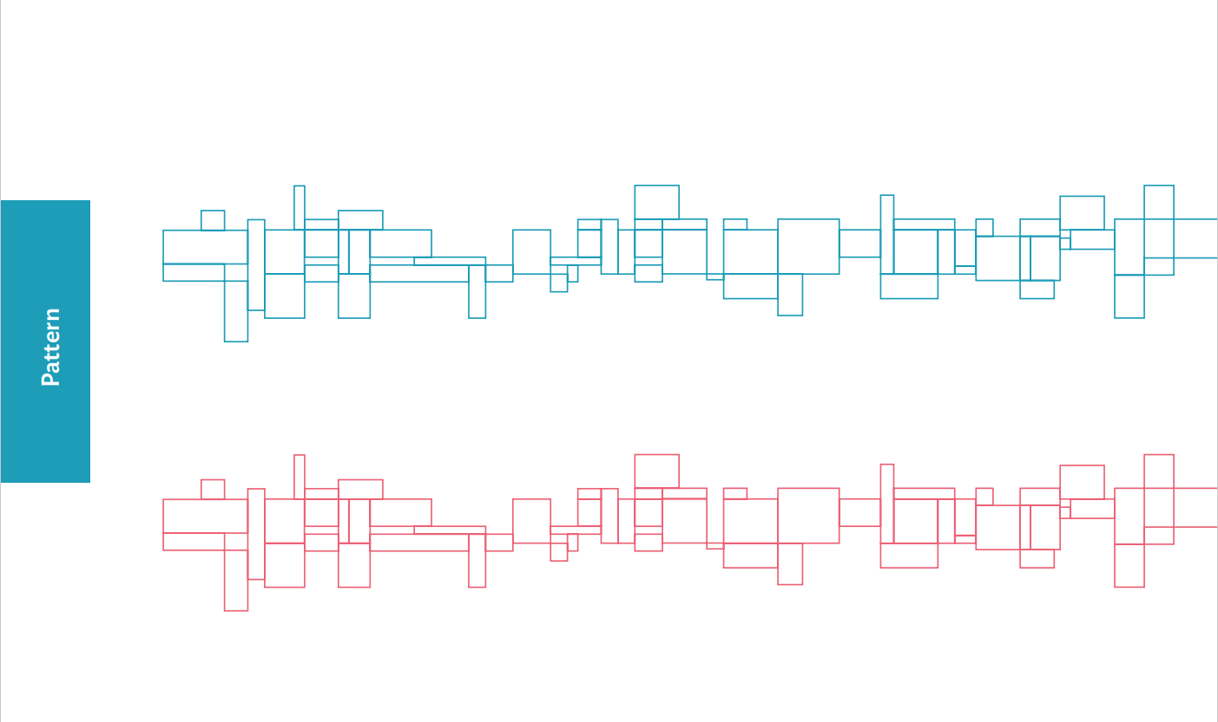
Brand Attributes
COLORS
Color plays an important role in the Tbilisi Mall corporate identity program. A palette of primary colours has been developed, the consistent use of these colours will contribute to the cohesive and harmonious look of the Tbilisi Mall brand identity across all relevant media.
PATTERN
A pattern is an extension of the brand that allows application in many diverse ways. The graphic is created specifically for Tbilisi Mall and reminds the viewer of its unique architecture as landmark in Georgia.

Slide 4
WEBSITE
PURPOSE/OBJECTIVE
FUNCTIONALITIES/STRUCTURE
PROJECT SCOPE
DESIGN
REFERENCES
UI & TECH REQUIREMENTS

Slide 5
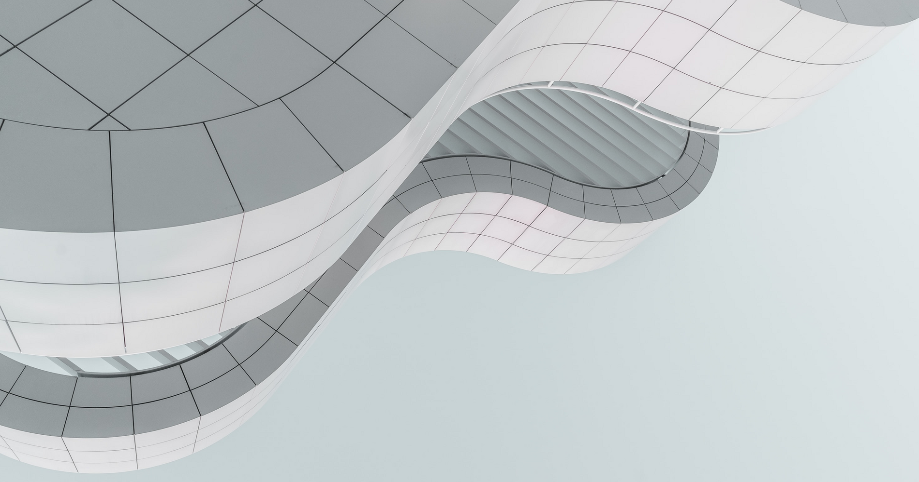
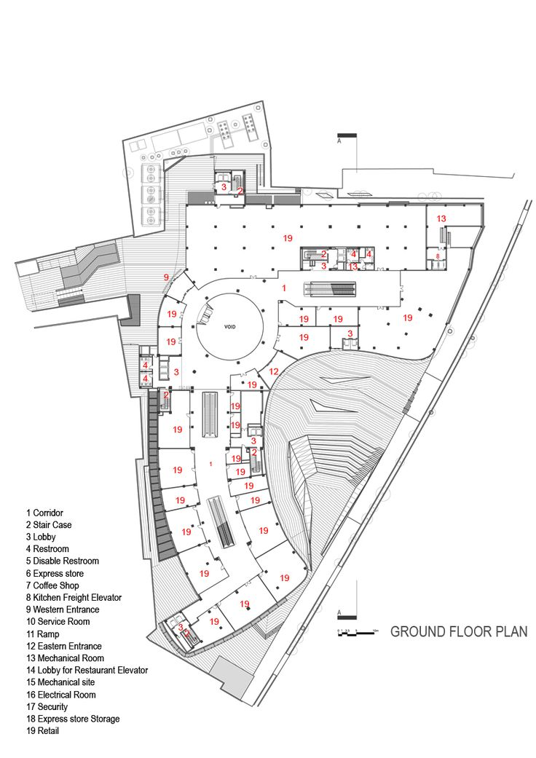
INTRODUCTION
PURPOSE OF THE WEBSITE
PURPOSE
Create a brand platform with contemporary design and engaging functionality;
Create a platform of multi-usage and informational, to ensure returning customers and high retention rate
Create emotional impact/impression and bonding between TBILISI MALL positioning and consumer
WEBSITE OBJECTIVE
Establish brand perception as a contemporary and tech-savvy
Improve holistic online presence with a responsive and accessible platform
Become a source of key information – deliver key information on stores, events, services and accessibility to consumers

Slide 6
INTRODUCTION
Functionalities/Structure
ABOUT US
Tbilisi Mall / Leasing / Frequently Asked questions
SHOPPING
Apparel / Toys / Health and beauty / Electronics / Optics / Specialty Stores etc
ENTERTAINMENT
Cinema / Zootopia / Bowling
DINNING
Fast food / Georgian / Café / Restaurant
SERVICES
Bank / Beauty Salon / Exchange etc
OFFERS
Promotions / New Collections etc
CONTACT
Address / How to get there / Working hours / Number
MAP
Map Per each floor and per filters (stores, entertainment, services etc)
NEWS
News/Press-releases
SOCIAL ICONS
GIFT CARD
SUBSCRIBE FIELD
LEGAL PAGES
Privacy policy / Terms & Conditions

Slide 7
PROJECT SCOPE
Functionalities/Structure
Develop and propose informational architecture (incl. sematic core, website content structure)
Develop and propose mechanic of roll-out and accessibility of brand innovative services and their communication within website
Develop and implement web design (layouts, animations, scripts)
Develop and implement approach to content delivery – infographics, illustrations (to move from text to visual way of information delivery)
Develop and roll out language instances (GE/EN) and connecting to e-commerce platforms
Handle initial launch, testing, support and transferring site to technical service partner
Develop UI kit
Develop and implement on-boarding and educational materials on how to work with the platform
Select, prove and implement CMS:
SaaS, compliant with GDPR, CCPA, etc., including requirements for hosting and data processing
Easy to use and updateable by company employees (Digital manager, Brand manager)
Able to create and own content models / WEB or HTML templates for variable purpose: promotional page, content sections and pages, news, etc. Easy-to-use page constructor is desirable option.
Clear workspace, administration and management roles (example - admin, content manager, etc.) for 50+ users
Consumer Feedback form with source type selection option (Tech, Product, Packaging, Ads)
Ability to integrate e-commerce APIs, example - Amazon API (buy button, product card, catalogue, etc.)
GTM, GA, Facebook pixel integration differentiated by country version
SEO friendly and ready (Google Search optimized)
CDN friendly
Secure from outside threats
Scalability for future functional additions – Ecommerce, Personal Cabinet, Loyalty program, Blog, Additional pages with various purposes

Slide 8
DESIGN
Functionalities/Structure
TBILISI MALL web-site design concept should prioritize user experience and aesthetics and should enhance the overall shopping experience for visitors with a magical touch and Premium/Aspirational Look and feel
KEY FEATURES & DESIGN ELEMENTS
Responsive design: Mobile first and optimized for all devices
Clean and Simple Layout: A minimalist approach to design, with clean lines, simple typography, and easy-to-use navigation.
Strong Visuals: High-quality images and videos that showcase the brand and services should be prominently featured on the site.
Interactive Elements: Interactive elements such as hover effects and dynamic scrolling can help make the site more engaging for visitors.
Mobile-First Approach: With most of the internet traffic coming from mobile devices, it's crucial to design a website with mobile users in mind first.
Personalization: Personalizing the user experience, such as through personalized recommendations or content, can help build a stronger connection with your audience.
Fast Loading Speed: A fast loading website not only enhances the user experience, but also helps with search engine optimization (SEO).
Clear Calls-to-Action: The website should include clear calls-to-action that guide users towards specific actions, such as making a purchase or signing up for a newsletter.

Slide 9
REFERENCES
Functionalities/Structure
Sawgrass Mills – Good example of the integrated maps/find a store
Tyson Mall – Good example of showing food courts/shops with view more info & map
Metropolis Mall – ideal introduction for tenants, good “About”
Surfhouse Barcelona – Homepage example
Swabtheworld - another good example of unique color combination and parallax that draws the eye and fullscreen experience
Spinx - Bold, fullscreen, clean experience with hovering and slightly animative elements
Hyer – interactive, full screen, clean interface and immersive

Slide 10
UI/UX REQUIREMENTS
Functionalities/Structure
USER EXPERIENCE
Navigation: clear, intuitive, and easy to use, allowing users to find what they're looking for quickly and easily.
Fast and Responsive: The website should load quickly and be optimized for fast performance, which can help to reduce bounce rates and improve overall user satisfaction.
Visuals: strong visual aesthetic that effectively showcases the brand. This can include high-quality images, videos, and graphics, as well as effective use of color, typography, and white space.
Interactivity: engaging interactions, such as animations, hover effects, and dynamic background elements. These elements can help to keep users engaged and provide a more immersive experience.
Mobile-Friendly: The website should be optimized for mobile devices, with a responsive design that adapts to different screen sizes and provides a seamless experience for users on any device.
Browser Compatibility: The website should be compatible with the most popular web browsers, such as Google Chrome, Mozilla Firefox, and Microsoft Edge, and should be tested on a variety of devices and screen sizes.
GENERAL TECH REQUIREMENTS
Hosting: The website must be hosted on a secure and reliable server, till it’s transferred to our technical service partner.
Security: Secure and protected against hacking, malware, and other security threats. required security measures - SSL certificate, firewall, and regular security updates, as well as regularly backing up the website data to protect against data loss or corruption.
Maintenance: regular maintenance to ensure that the web-site continues to function as expected, and that any issues or bugs are quickly resolved. This includes website software and plugin regular update, website for compatibility testing with new devices and browsers, and fixing any broken links or other issues that arise.
Scalability: Website must be scalable - easily accommodate increased traffic and new features
Analytics: Website should be equipped with web analytics tools (i.e. Google Analytics) to track user behavior and website performance, and to help inform decisions about future updates and improvements to the website.
SPECIAL FUNCTIONALITIES
Social media integration: social media feed integration, social sharing buttons, and social media log-in options.
Custom forms: contact forms, survey forms, and registration forms, to gather information from users, which must be customizable to meet specific needs of the business.
Search functionality: To help users quickly find the information they are looking for, including advanced search options. Additional search functionality with filter for maps
User account management: user login, profile management, and password reset
Multi-language support: multi-language support, with the ability to translate the website content into multiple languages.

Slide 11
CONTENT

Slide 12
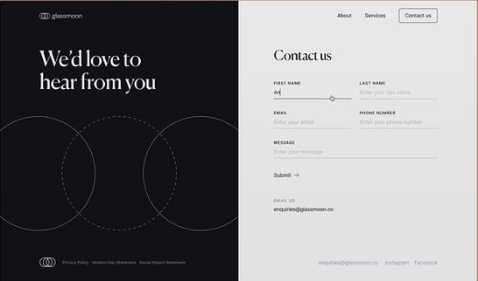
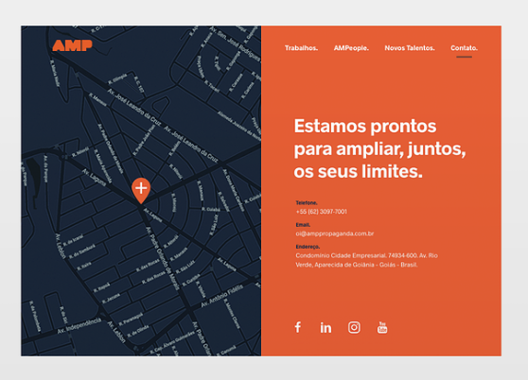
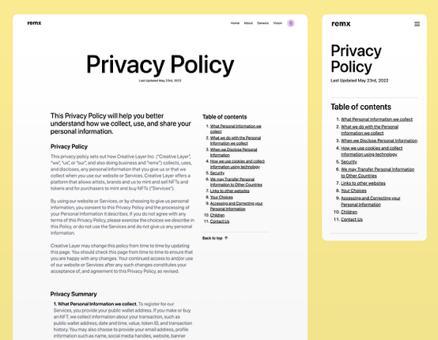
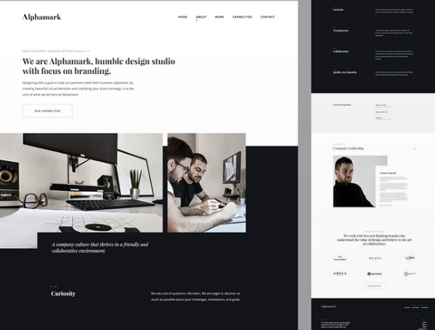
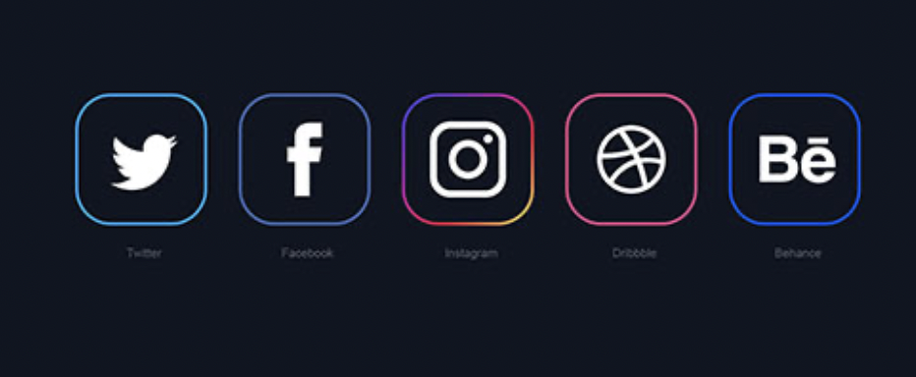
SUBSCRIBE FIELD
Automated data-saving and sending all updates to subscribed users weekly
INTRODUCTION
Functionalities/Structure
CONTACT
Address / How to get there / Working hours / Number
ABOUT US
Tbilisi Mall – who we are, what we stand for, what we offer customers
Gift Card
Leasing
Frequently Asked questions - comprehensive FAQ section to address common queries related to mall services, policies, and facilities.
Cusrtomer support - through various channels, such as chat, email, or a helpline.
LEGAL PAGES
Privacy policy / Terms & Conditions
SOCIAL ICONS
GIFT CARD
Information about Git card, where and how to buy/Pre-order button

Slide 13
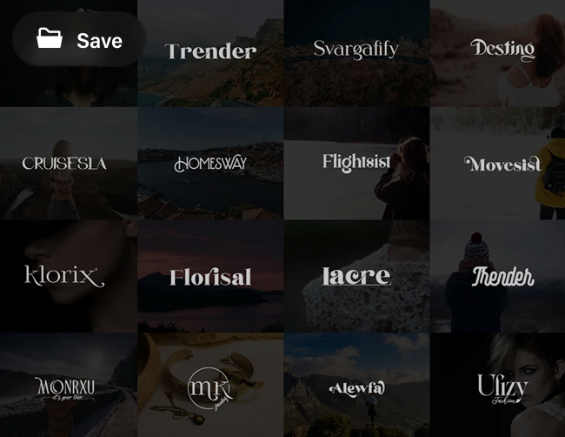
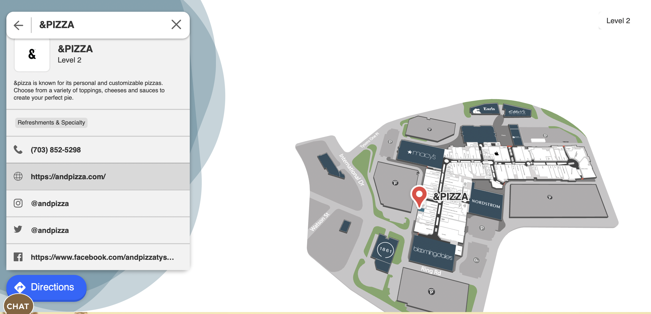
INTRODUCTION
Functionalities/Structure
SHOPPING
ENTERTAINMENT
DINNING
SERVICES
Showcasing directions:
SHOPPING - Apparel / Toys / Health and beauty / Electronics / Optics / Specialty Stores etc
ENTERTAINMENT - Cinema / Zootopia / Bowling
DINNING - Fast food / Georgian / Café / Restaurant
SERVICES - Bank / Beauty Salon / Exchange etc
And under the directions – brands/tenants
Each brand should have information about the brand, Social media redirection, contacts and location on the map

Slide 14
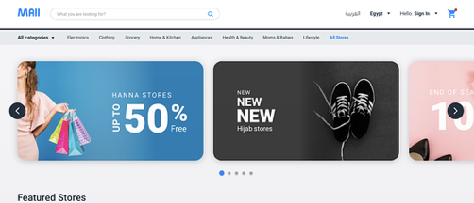
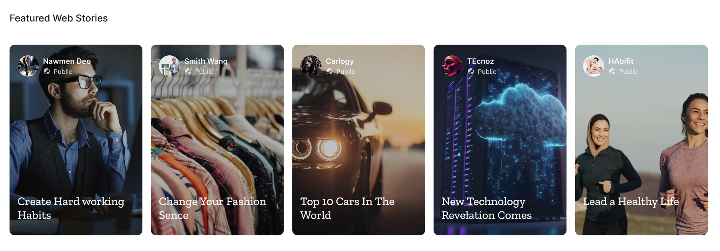
INTRODUCTION
Functionalities/Structure
MAP
Mall Map for each floor and searchable through filters:
- stores
- entertainment
- services etc)
OFFERS
Up to date information about promotions and new Collections etc, also redirectable to the about/location of the tenant
NEWS
News/Press-releases

Slide 15
WAYFINDER

Slide 16
DIGITAL WAYFINDER
MAP & WEB INTEGRATION
MAP
- Creation and configuration of the interactive map (up to 160 objects) incl. Building infrastructure and objects: tenants, entrances, toilets, emergency exits, escalators, etc
- Full information insertion about tenants: Name, opening hours, description, promotions, offers (more detailed info on the web)
- User web-interface for QR wayfinding customization
- Generation and placement of QR codes on the interactive map, preparation of files in vector format for the customer
- Creation and configuration of the parking map (up to 400 pcs) Generation and placement of QR codes on the map
- Creating informational content and Navigation signs layout forms and preparation production files
- Map integration and Production/installation of QR navigation elements on the website
- Training employees to work with the system and detailed ‘How to” document/KIT
IMPLEMENTATION
- Cloud service & license
- Built in map editor that doesn’t require 3rd party software for user management, publishing content on all connected digital assets, analytics and reports
- Web service for publishing content, including the map to the website
- Web service for QR-wayfinding including end-user interface for displaying directions
- User testing and feedback

Slide 17
TIMELINE & DELIVERABLES

Slide 18
AGENCY DELIVERABLES
Share Project plan, timings (activity grid calendar) and detailed budget
Create new website concept & Structure with aspirational, magic & authentic design and immersive / engaging functionality – 2 concepts
Propose technological solution / platform (CMS) and arguments behind the proposal – at least 3 solutions evaluated
Develop website prototypes (UX) / wireframes (Figma or similar)
UX test reports
Textual, SEO and rich media content for international English and GEO version
Content models / templates development for different communication purposes (sales promo, new campaign launch, recipes pages, etc.)
Testing and QA report
Design and UI kit document, guidelines and manuals for client team on-boarding
Transfer IP licenses, accesses to 3rd party services, source files of designs, illustrations, texts, mockups, etc.
Always-on Creative & Technical support, quarterly performance monitoring & Optimization Recommendation
TIMELINE
Proposed initial time schedule, that will help us to align update of the website.
More detailed timeline with concrete deliverables should be created further down the road of project.
Agency briefing – (1 week)
Strategy and planning – (1 weeks)
Design and first look at prototype – (2 weeks)
Development and programing – (4 weeks)
Content development/SEO – (1 weeks)
Content upload - (1 weeks)
Beta testing and reviewing – (2 weeks)
Web-site launch – (1 week)
Maintenance and enhancements – Ongoing

Slide 19
THANK YOU

