Slide 1
Food Court Redesign of Area to “Food Hall”
Leasing Department

Slide 2
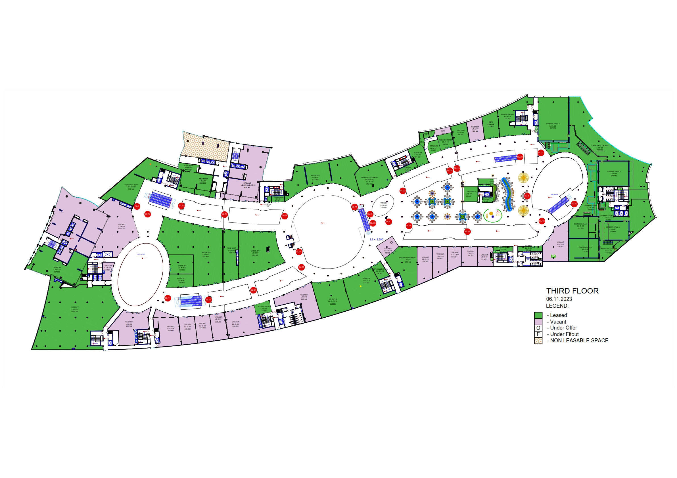
Current FC Area
Food Court Area – 2,695 sqm
Number of Food Oepratirs-12
Vacant Space - 894 sqm

Slide 3
Current FC Area – Challenge
Big areas left in vacancy – 896 sqm
Area of 562 sqm gives an opportunity to convert it on demandable sized areas.

Slide 4
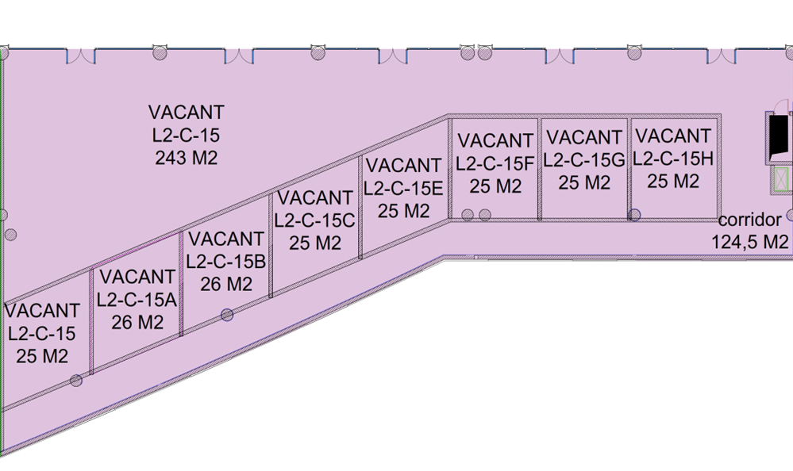
Development/Resizing

Slide 5
Development/Resizing

Slide 6
Development/Resizing Plan

Slide 7
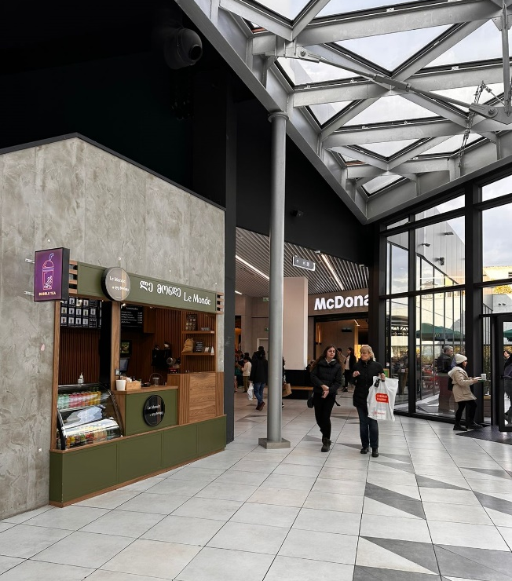
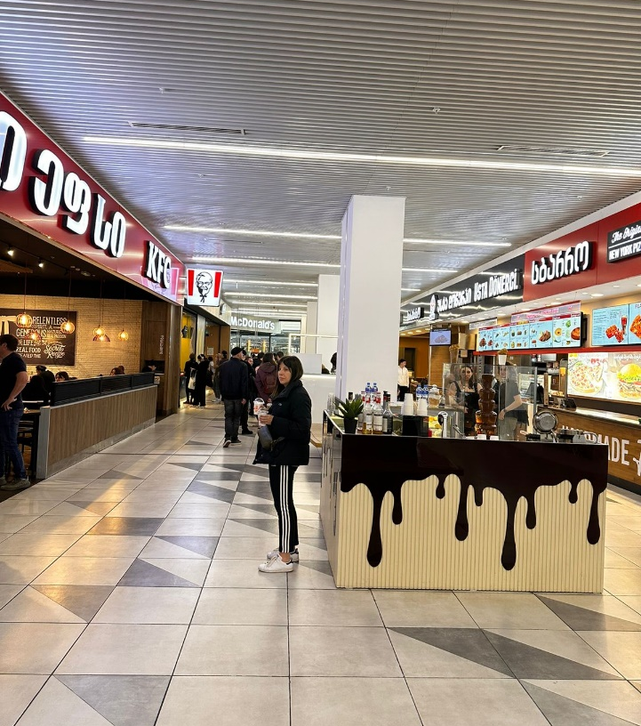
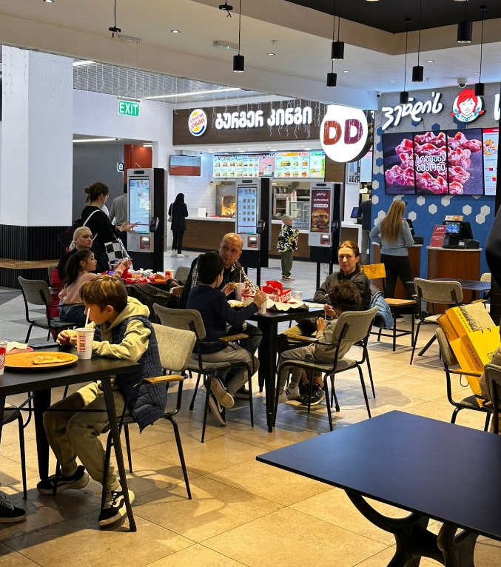
City Mall Food Court

Slide 8
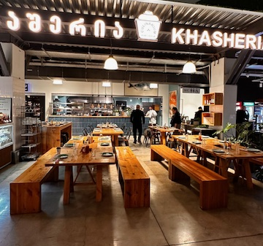
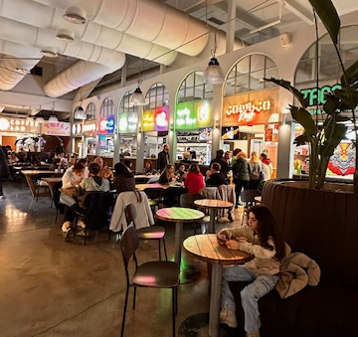
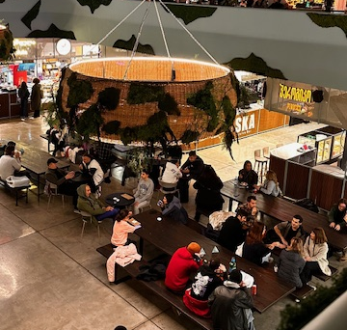
Orbeliani Bazaar Food Court

Slide 9
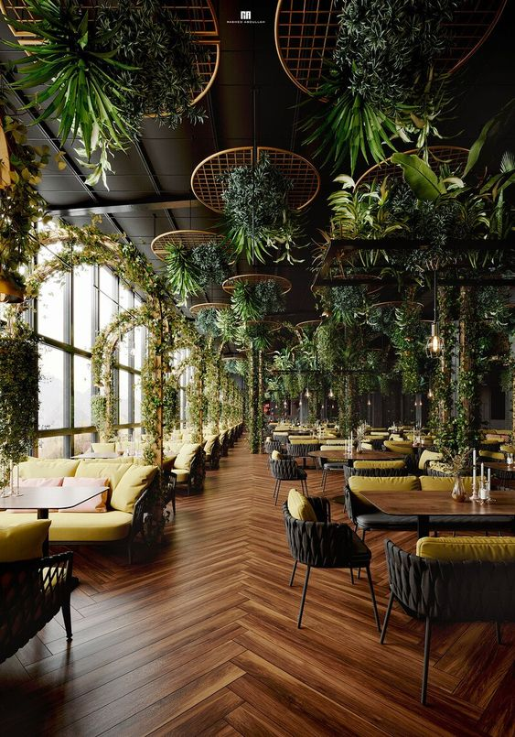
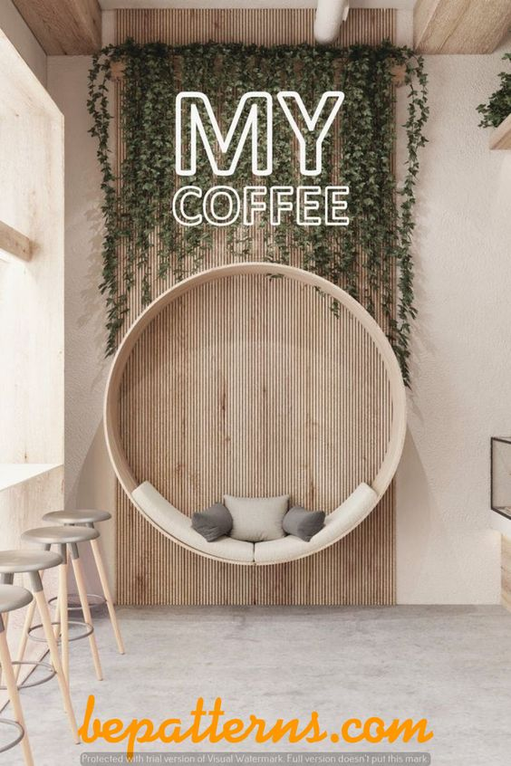
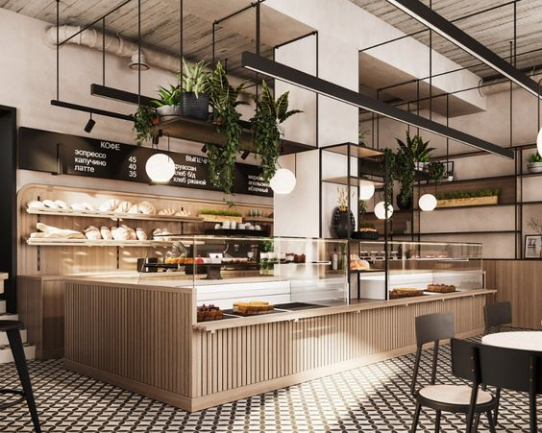
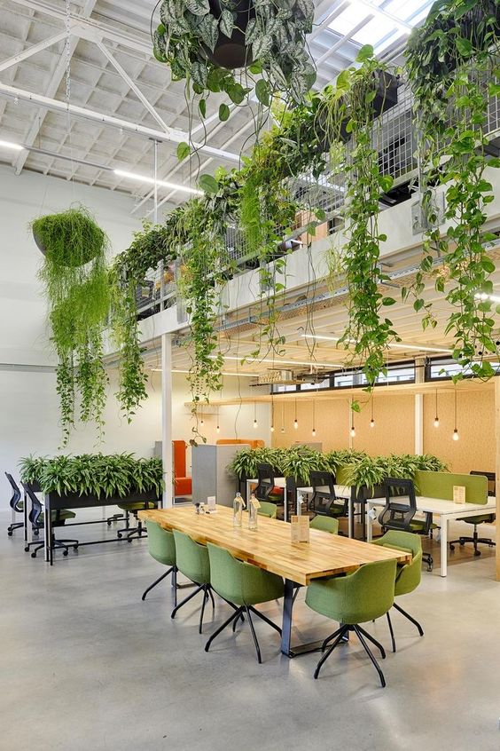
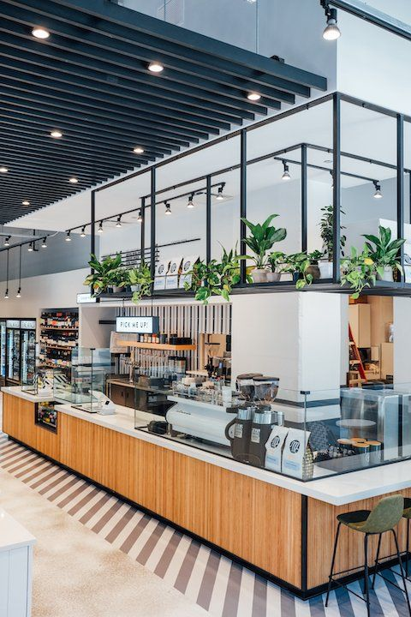
Some ideas /main priorities
Space should be inviting, cozy and comfortable
Space should be in line with TM Food court design concept
Lights should be appropriate as it has to be in food area (soft, warm) Greenery should take place as well as wood elements
Some relax zones may be considered.
Big tables for 8-10 persons ( Italian style)
Ceiling
Stall
Tables
Relax Area
Flooring

Slide 10
Thank you

